Slide 1



Operating Systems and Environments
Prepared & Presented by: Mirlan Nurbekov, Lecturer
Office hours: Friday 9:00–17:00
AlaToo IT & Business College
Fall 2025

Slide 2
Course Introduction
This course provides a comprehensive overview of the principles and architecture of modern operating systems—the foundation of all computer systems. Students will explore how operating systems manage hardware and software resources to ensure efficiency, stability, and security. Key topics include process and thread management, memory organization, file systems, CPU scheduling, device control, and system security. By the end of the course, students will be able to analyze and evaluate core OS mechanisms that enable multitasking, synchronization, and resource sharing in modern computing environments.

Slide 3
Grading & Assessment
Midterm test: teamwork research and presentation with report (100 points)
Final exam (100 points)

Slide 4


Slide 5
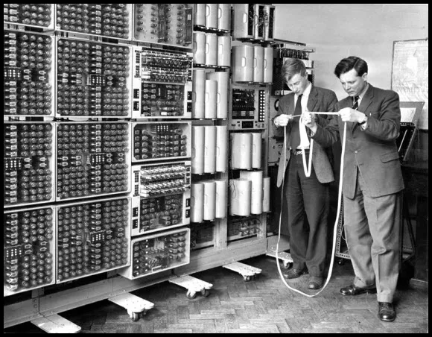
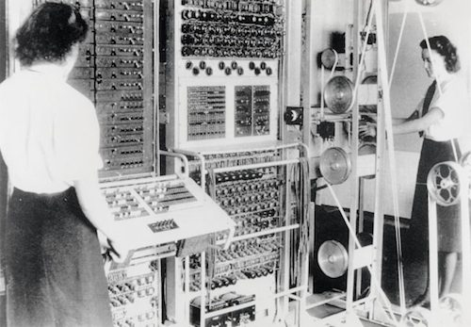

Slide 6


Slide 7
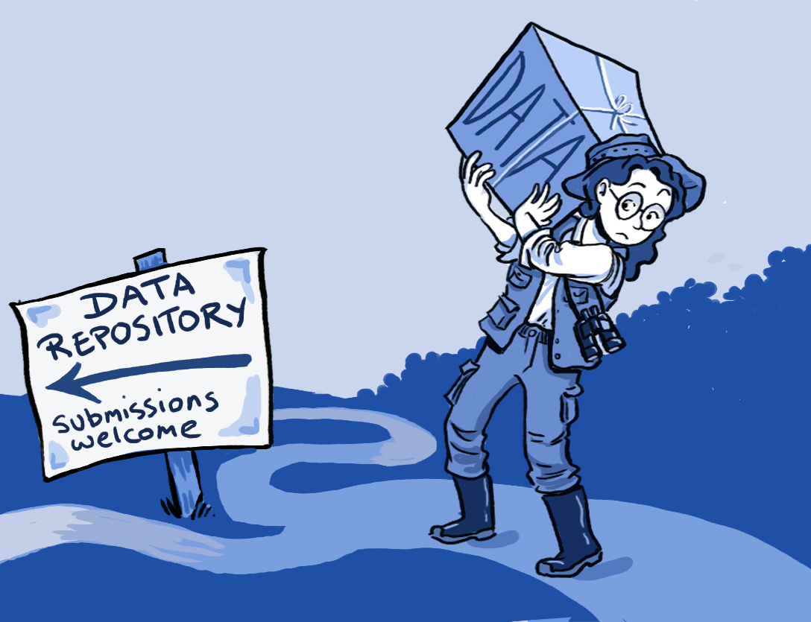

Slide 8
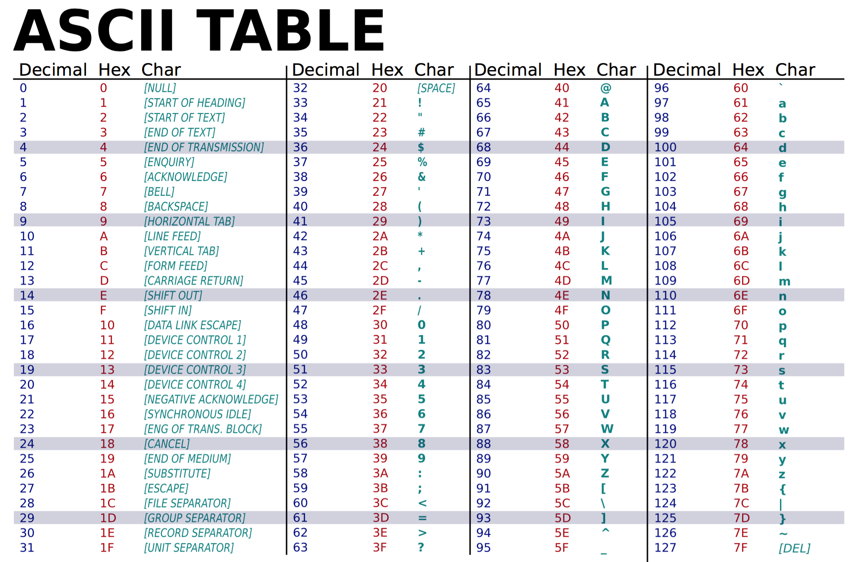

Slide 9
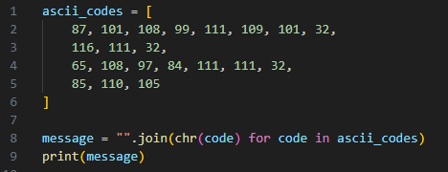

Slide 10
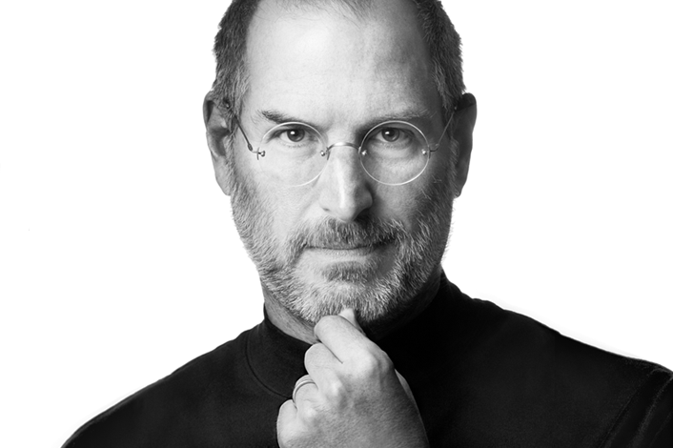
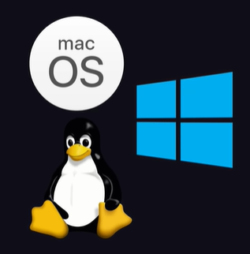

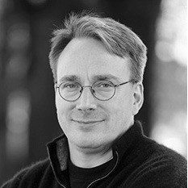

Slide 11


Slide 12


Slide 13


Slide 14
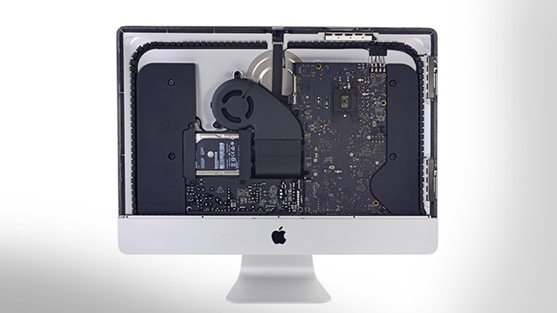

Slide 15
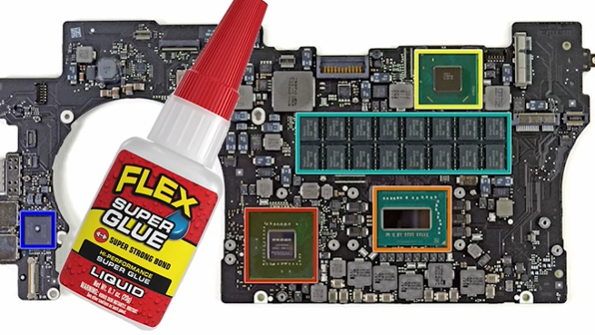

Slide 16
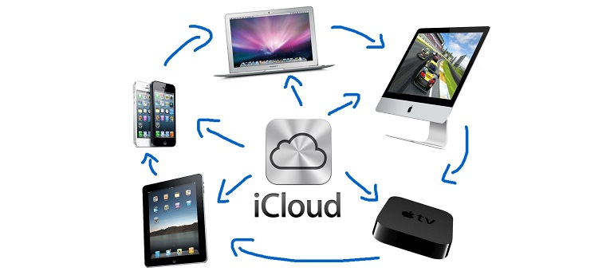

Slide 17
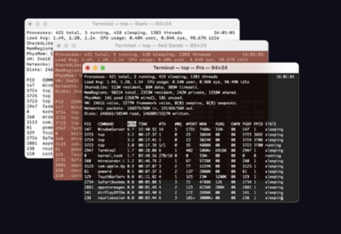
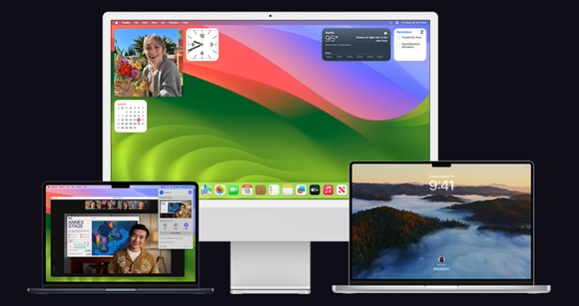

Slide 18


Slide 19


Slide 20
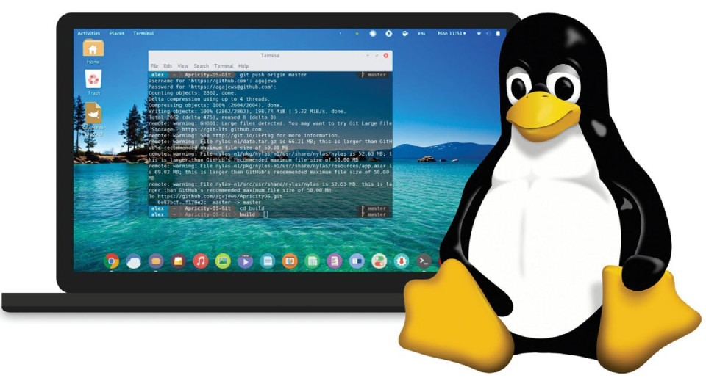

Slide 21
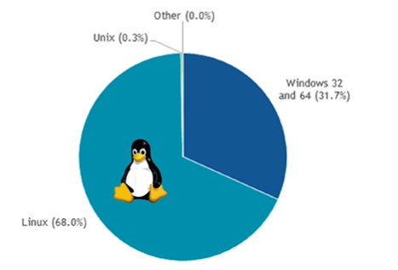

Slide 22
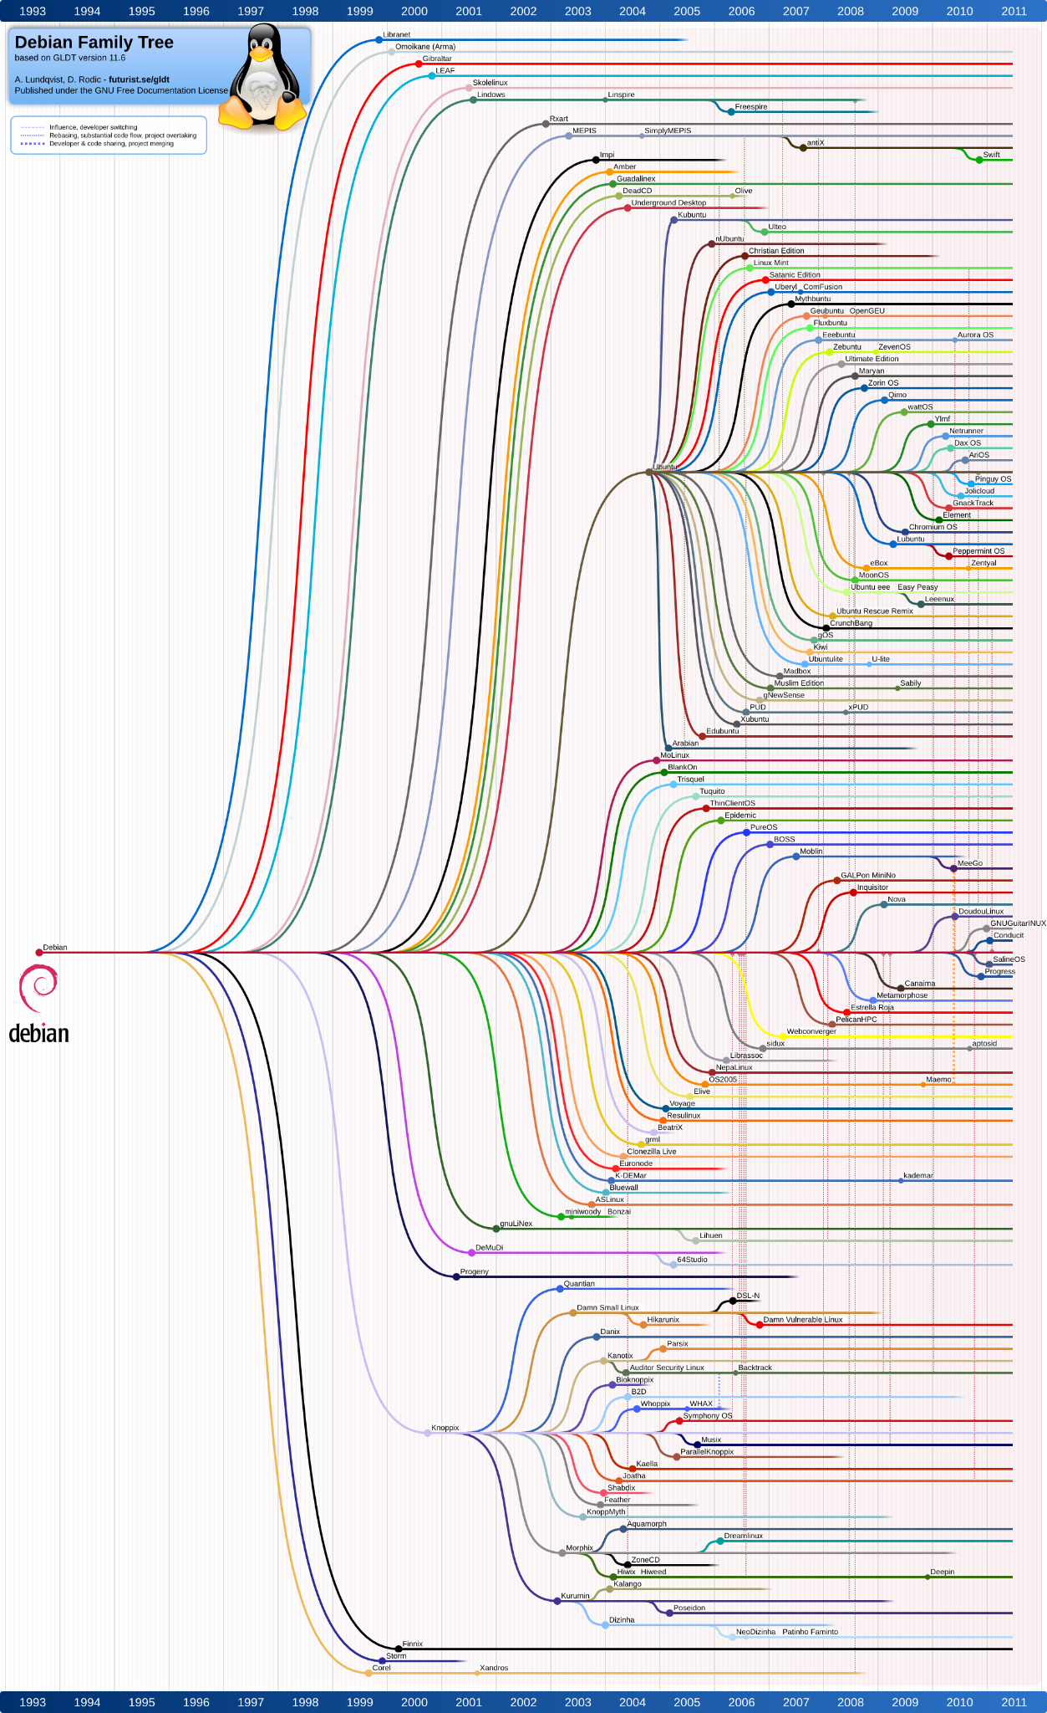

Slide 23


Slide 24


Slide 25
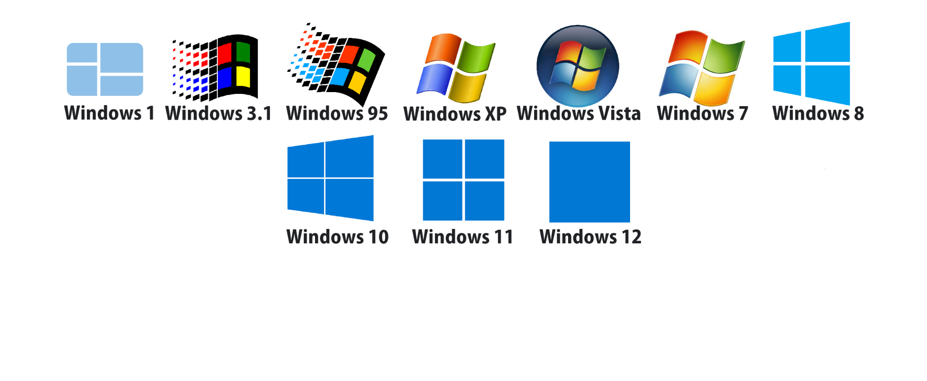

Slide 26
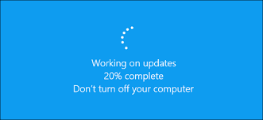
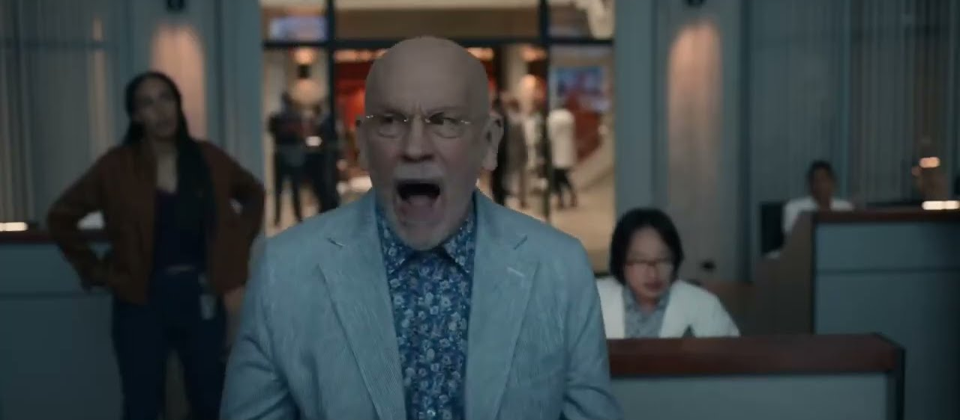

Slide 27
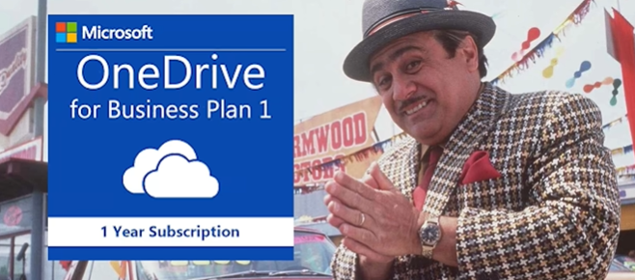


Slide 28
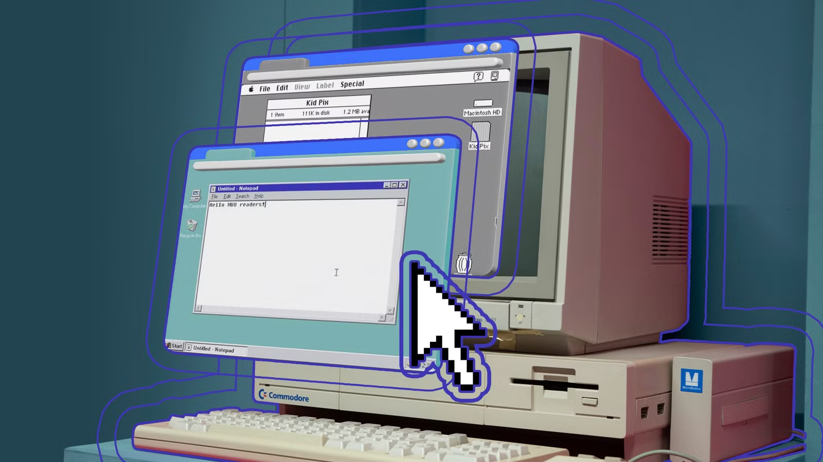
Run old OS in your browser

Slide 29
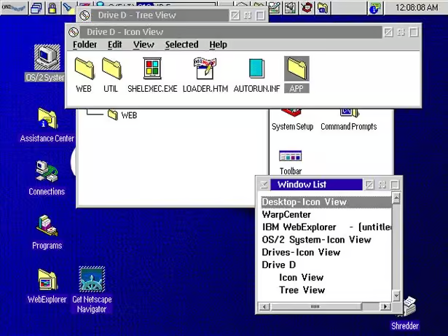

https://copy.sh/

Slide 30
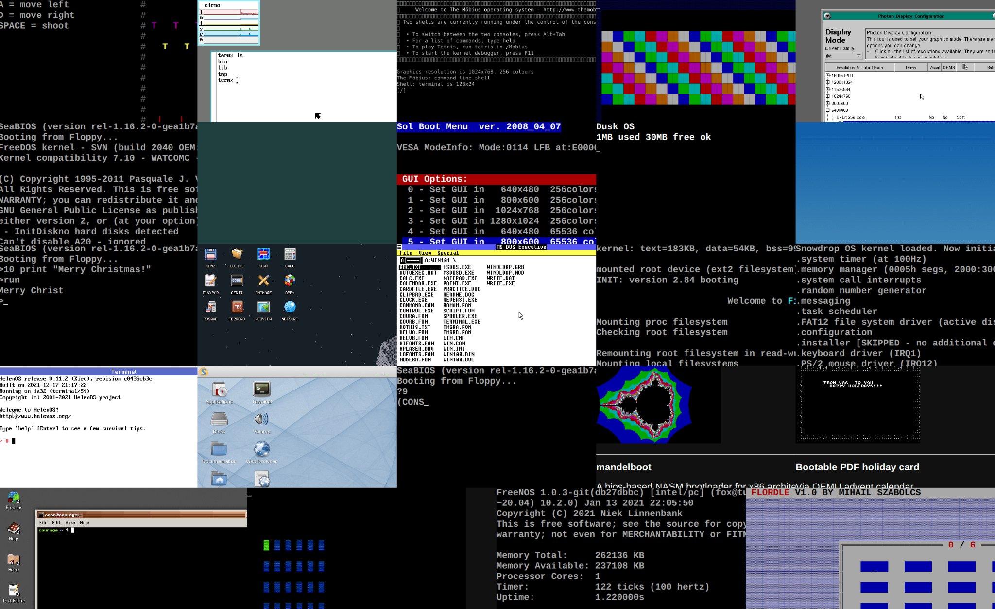

Slide 31

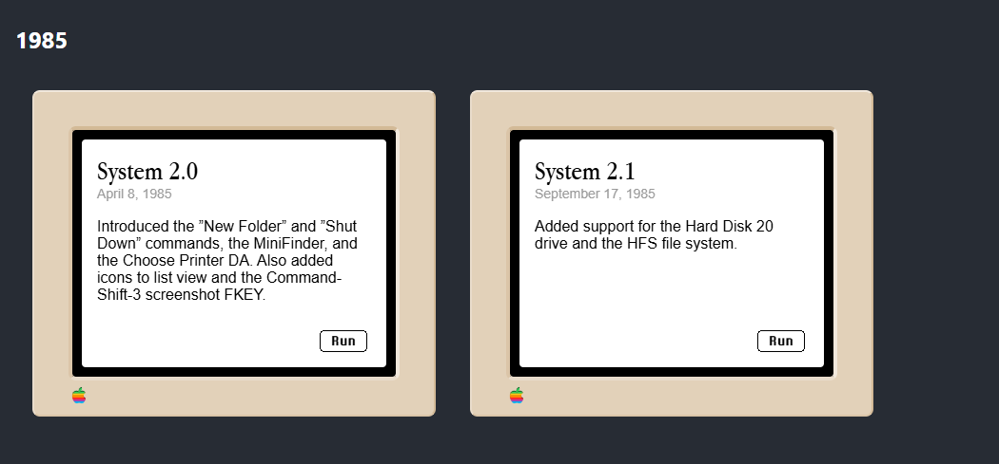
https://infinitemac.org/

Slide 32
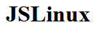
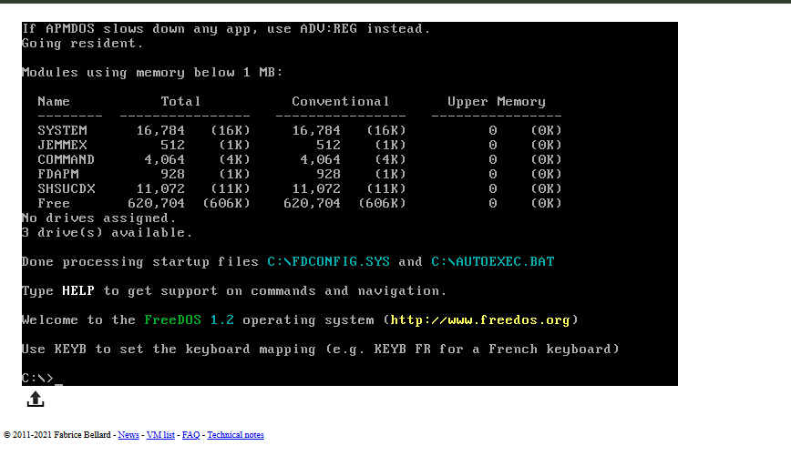
https://bellard.org/jslinux/

